Slide 1
Week 3- Ethics and Social Responsibility

Slide 2
What is ethical behaviour?
Ethics set standards as to what is good or bad, or right or wrong in a person’s conduct.
Values
  Basic convictions about what is right and wrong.
  Broad beliefs about what is or is not appropriate behaviour.
Notes:
Global warming, global sustainability and environmental protection are all on the agenda as organisations pursue what some call ‘the greening of the bottom line’.
It is time to get serious about the moral aspects and social implications of decision making in organisations. Performance goals must always be achieved through ethically and socially responsible action.
What is ethical behaviour?
Ethics can be defined as the code of moral principles that sets standards of good or bad, or right or wrong, in a person’s conduct and thereby guides the behaviour of that person or group. These principles guide behaviour and help people make moral choices among alternative courses of action. In practice, ethical behaviour is that which is accepted to be ‘good’, ‘right’ and ‘proper’ as opposed to ‘bad’ or ‘wrong’ or ‘improper’ in the context of the governing moral code.
Most ethical problems in the workplace arise when people are asked to do, or find themselves about to do, something that violates the dictates of their conscience. For some, if the act is legal they proceed with confidence. For others, the ethical test goes beyond the legality of the act alone. The ethical question extends to personal values — the underlying beliefs and attitudes that help determine individual behaviour. To the extent that values vary among people, we can expect different interpretations of what behaviour is ethical or unethical in a given situation.

Slide 3
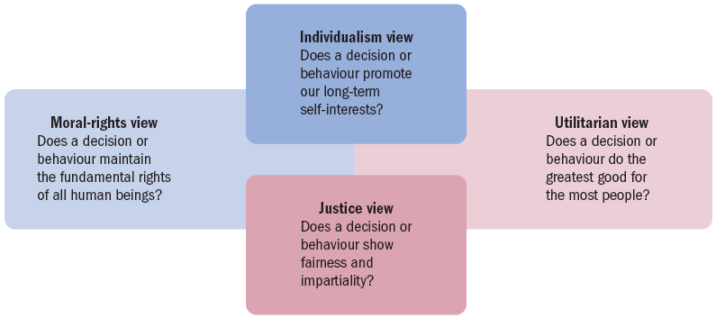
Four view of ethical behaviour
Alternative views of ethical behaviour

Slide 4
Alternative views of ethical behaviour（1/2）
There are four different interpretations of what constitutes ethical behaviour:
  The Utilitarian View considers ethical behaviour as that which delivers the greatest good to the greatest number of people.
  The Individualism View considers ethical behaviour as that which advances long-term self-interests.
  The Moral-rights View considers ethical behaviour as that which respects and protects the fundamental rights of people.
Notes:
Alternative views of ethical behaviour
There are many different interpretations of what constitutes ethical behaviour.
The utilitarian view considers ethical behaviour as that which delivers the greatest good to the greatest number of people. Founded in the work of 19th century philosopher John Stuart Mill, this is a results-oriented point of view that tries to assess the moral implications of decisions in terms of their consequences.
The individualism view considers ethical behaviour as that which advances long-term self-interests. When people pursue individual self interests, they supposedly become self-regulating.
The moral-rights view considers ethical behaviour as that which respects and protects the fundamental rights of people. In many organisations today, this concept extends to ensuring that employees are always protected in their rights to privacy, due process, free speech, free consent, health and safety, and freedom of conscience.

Slide 5
Alternative views of ethical behaviour(2/2)
The Justice View considers ethical behaviour as that which treats people impartially and fairly according to guiding rules and standards.
  Procedural justice is concerned that policies and rules are fairly administered.
  Distributive justice is concerned that people are treated the same regardless of individual characteristics.
  Interactional justice is the degree to which others are treated with dignity and respect.
  Commutative justice is the degree to which an exchange or a transaction is fair to all parties
Notes:
The justice view of moral behaviour is based on the belief that ethical decisions treat people impartially and fairly according to guiding rules and standards. This approach evaluates the ethical aspects of any decision on the basis of whether it is ‘equitable’ for everyone affected. One justice issue in organisations is procedural justice — the degree to which policies and rules are fairly administered.
A second issue is distributive justice — the degree to which outcomes are allocated without respect to individual characteristics based on ethnicity, race, gender, age or other criteria. For example, does a woman with the same qualifications and experience as a man receive the same consideration for hiring or promotion? A third issue is interactional justice — the degree to which others are treated with dignity and respect.

Slide 6
Ethical dilemmas
Sources of ethical dilemmas include:
  Discrimination – denying promotion due to race, religion, gender, age or another non-job relevant criterion
  Sexual harassment
  Conflicts of interest
  Product safety
  Organisational resources
Notes:
Ethical problems faced by managers
There are many potential sources of ethical dilemmas including:
• discrimination — where a manager denies promotion or appointment to a job candidate because of the candidate’s race, religion, gender, age or other criterion not relevant to the job
• sexual harassment — where a manager makes a co-worker feel uncomfortable because of inappropriate comments or actions regarding sexuality; or where a manager requests sexual favours in return for favourable job treatment
• conflicts of interest — where a manager takes a bribe or kickback or extraordinary gift in return for making a decision favourable to the gift giver
• customer confidence — where a manager has privileged information regarding the activities of a customer and shares that information with another party
• organisational resources — where a manager uses official stationery or a company email account to communicate personal opinions or requests to community organisations.

Slide 7
Rationalisations for unethical behaviour
Four common rationalisations that are used to justify misconduct:
  1. Convince yourself that the behaviour is not really illegal.
  2. Convince yourself that the behaviour is really in everyone’s best interests.
  3. Convince yourself that nobody will ever find out what you’ve done.
  4. Convince yourself that the organisation will ‘protect’ you.
When in doubt about taking an action, don’t do it.
Notes:
Rationalisations for unethical behaviour
Why might otherwise reasonable people act unethically?
There are at least four common rationalisations that are used to justify misconduct in these and other ethical dilemmas.
1. Convince yourself that the behaviour is not really illegal.
2. Convince yourself that the behaviour is really in everyone’s best interests.
3. Convince yourself that nobody will ever find out what you’ve done.
4. Convince yourself that the organisation will ‘protect’ you.
After doing something that might be considered unethical, a rationaliser says, ‘It’s not really illegal’.
When in doubt about a decision to be made or an action to be taken, don’t do it.

Slide 8
How can an organisation maintain Ethical Standards?
Ethical role models
Maintaining high ethical standards
Codes of ethics
Notes:
Ethical role models
The late Anita Roddick, founder and former executive director of The Body Shop International opened the first store in Brighton, England, in 1976. She devoted most of her working life to finding new ways of doing business and looking for ways business can take the lead in making the world a better place.
Top managers in large and small businesses have the power to shape their organisation’s policies and set its moral tone. They also have a major responsibility to use this power well. They can and should serve as role models of appropriate ethical behaviour for the entire organisation. Not only must their day-to-day behaviour be the epitome of high ethical conduct, but top managers must also communicate similar expectations throughout the organisation, and reinforce positive results.
All managers must act as ethical role models and set an ethical tone in their areas of responsibility.
Part of the manager’s ethical responsibility is to be realistic in setting performance goals for others.

Slide 9
Perspectives on social responsibility
The classical view holds that management’s only responsibility in running a business is to maximise profits.
The socioeconomic view holds that management of any organisation must be concerned for the broader social welfare and not just for corporate profits.
Notes:
Perspectives on social responsibility
In academic and public-policy circles, two contrasting views of corporate social responsibility have stimulated debate.
The classical view holds that management’s only responsibility in running a business is to maximise profits. In other words — the business of business is business and the main concern of management should always be to maximise shareholder value.
The arguments against corporate social responsibility include fears that the pursuit of this goal will reduce business profits, raise business costs, dilute business purpose, give business too much social power, and do so without business accountability to the public.
In contrast, the socioeconomic view holds that management of any organisation must be concerned for the broader social welfare and not just for corporate profits.
Among the arguments in favour of corporate social responsibility are that it will add long-term profits for businesses, improve the public image of businesses, and help them to avoid more government regulation. Businesses have the resources and ethical obligation to act responsibly.

Slide 10
From Obligation to Responsiveness to Responsibility
Social obligation: when a firm engages in social actions because of its obligation to meet certain economic and legal responsibilities
Social responsiveness: is when a company engages in social actions in response to some popular social need
Social responsibility: A business’s intention, beyond its legal and economic obligations, to do the right things and act in ways that are good for society
Notes:
The other two concepts—social responsiveness and social responsibility—reflect the socioeconomic view, which says that managers’ social responsibilities go beyond making profits to include protecting and improving society’s welfare. This view is based on the belief that corporations are not independent entities responsible only to stockholders, but have an obligation to the larger society. Organizations around the world have embraced this view as shown by a survey of global executives in which 84 percent said that companies must balance obligations to shareholders with obligations to the public good.
Social responsiveness is when a company engages in social actions in response to some popular social need. Managers are guided by social norms and values and make practical, market-oriented decisions about their actions. For instance, Ford Motor Company became the first automaker to endorse a federal ban on sending text messages while driving.
A socially responsible organization goes beyond what it’s obligated to do or chooses to do because of some popular social need and does what it can to help improve society because it’s the right thing to do. We define social responsibility as a business’s intention, beyond its legal and economic obligations, to do the right things and act in ways that are good for society. A socially responsible organization does what is right because it feels it has an ethical responsibility to do so.

Slide 11
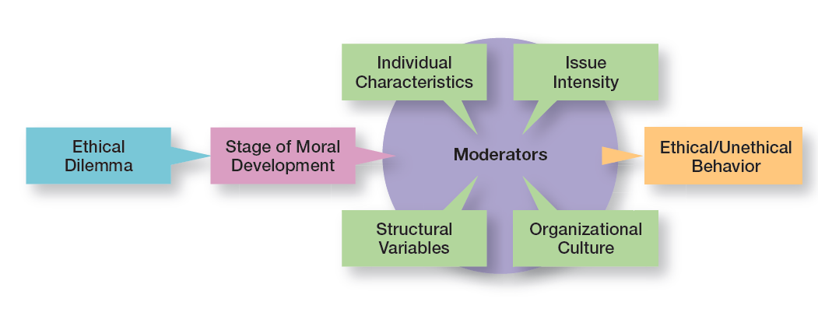
Factors that Determine Ethical and Unethical Behavior

Slide 12
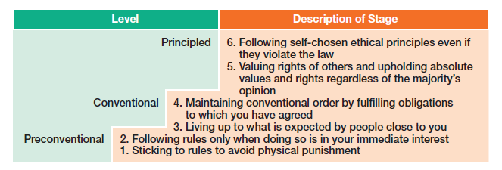
Stages of Moral Development

